Slide 1
LEAD DATA INC.
Investor Conference
2021.12.30
LEAD DATA INC.

Slide 2
Company Overview
Established in 1996
IPO in Nov. 1996
Mass production of CD-R、DVD-R 、DVD-RAM in 1997
Stock listed in TWSE on Jan. 2001 (Code:2443)
Formally moves into harbor logistic business in Aug. 2014
Set up commodities business, cement and coal, in Oct. 2015
LEAD DATA INC.

Slide 3
Business Unit
BU | BU Introduction
Commodity Trading | Coal trading business
Medical Equipment | Main Product：Mask、Covid-19 rapid test kits、Oxygen Concentrator and Hearing Aids etc.
Harbor Logistic | Tainan Anping Harbor bulk pack load/unload, storage and delivery service.
LEAD DATA INC.

Slide 4
Coal Trading Business
Rich Logistics, one of our subsidiary, cooperated with Taiwan Harbor Company Kaohsiung branch build up the bulk pack commodities warehouse at dock No.13~15 of Tainan Anping Harbor. Established a storage and transportation center with the total capacity of 40,000 ton.
The center has started operation on Jun. 2015, with the warehouse we rent in the north and central, we are able to offer our customers automatic coal unloading and delivery services.
LEAD DATA INC.

Slide 5
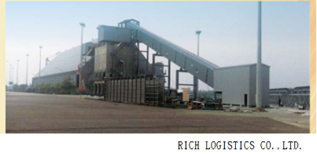
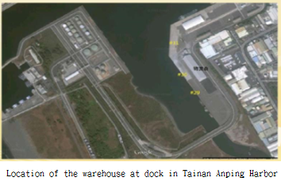
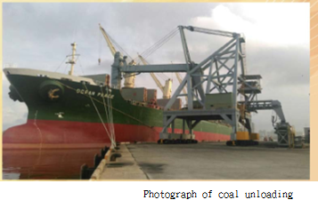
LEAD DATA INC.

Slide 6
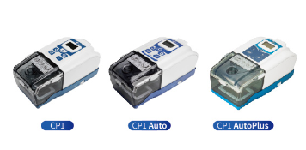
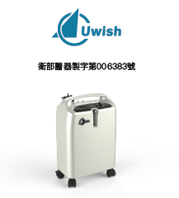

Medical Equipment
Our subsidiary Etop Union and ChungHong Electronics (Suzhou/Shenyang) entered medical equipment field since 2008. Dedicate to offer the market high quality medical aids.
Uwish CPAPs
Uwish Oxygen
Concentrator
Hearing Aid
LEAD DATA INC.

Slide 7
Finance and Operation Overview
LEAD DATA INC.

Slide 8
Income Statements Overview (Consolidated)
(NTＤ：Ｋ) |  | Q3 2021 |  |  |  | Q2 2021 |  |  |  | Q1 2021
 |  | Amount |  | ％ |  | Amount |  | ％ |  | Amount |  | ％
Sales |  | 14,067 |  | 100 |  | 27,498 |  | 100 |  | 153,363 |  | 100
Gross profit |  | (5,366) |  | (38) |  | (12,840) |  | (47) |  | 2,243 |  | 2
Operating Income |  | (12,730) |  | (90) |  | (49,107) |  | (179) |  | (52,549) |  | (34)
Income before tax |  | (13,288) |  | (94) |  | (37,018) |  | (135) |  | (49,288) |  | (34)
Net income |  | (13,288) |  | (94) |  | (37,018) |  | (135) |  | (49,288) |  | (34)
EBITDA |  | (6,762) |  |  |  | (29,076) |  |  |  | (41,971)
EPS |  | (0.09) |  |  |  | (0.24) |  |  |  | (0.33)
LEAD DATA INC.

Slide 9
Sales Breakdown
(NTD：K) |  | Q3 2021 |  |  |  | Q2 2021 |  |  |  | Q1 2021
 |  | Amount |  | ％ |  | Amount |  | ％ |  | Amount |  | ％
Trading |  | 2,665 |  | 14 |  | 9,829 |  | 36 |  | 120,865 |  | 79
Machinery |  | 2,037 |  | 14 |  | 8,079 |  | 29 |  | - |  | -
Transportation |  | 6,010 |  | 43 |  | 8,197 |  | 30 |  | 17,228 |  | 11
Medical equipment |  | 3,355 |  | 29 |  | 1,393 |  | 5 |  | 15,270 |  | 10
Total |  | 14,067 |  | 100 |  | 27,498 |  | 100 |  | 153,363 |  | 100
LEAD DATA INC.

Slide 10
Balance Sheet Overview (Consolidated)
(NTD：K) |  | 2021.9.30 |  |  |  | 2021.6.30 |  |  |  | 2021.3.31
 |  | Amount |  | ％ |  | Amount |  | ％ |  | Amount |  | ％
Cash |  | 350,548 |  | 53 |  | 237,019 |  | 35 |  | 127,914 |  | 17
Account receivable |  | 12,977 |  | 1 |  | 12,701 |  | 1 |  | 45,066 |  | 6
Inventory |  | 12,318 |  | 2 |  | 22,109 |  | 3 |  | 25,594 |  | 3
Other current assets |  | 24,758 |  | 4 |  | 149,429 |  | 22 |  | 152,714 |  | 20
PPE & investment property |  | 129,014 |  | 20 |  | 130,036 |  | 20 |  | 132,551 |  | 18
Right-of-Use Asset |  | 98,909 |  | 15 |  | 103,181 |  | 15 |  | 115,744 |  | 16
Total Assets |  | 659,221 |  | 100 |  | 683,983 |  | 100 |  | 751,199 |  | 100
Short-term Loan |  | - |  | - |  | - |  | - |  | - |  | -
Current contract liabilities |  | 1,313 |  | - |  | 3,966 |  | - |  | 8,570 |  | 1
Accounts Payable |  | 125,115 |  | 19 |  | 124,682 |  | 18 |  | 136,544 |  | 18
Lease Liabilities |  | 61,829 |  | 9 |  | 64,882 |  | 9 |  | 76,492 |  | 11
Other Current Liabilities |  | 1,139 |  | - |  | 1,426 |  | - |  | 1,250 |  | -
Shareholder’s Equity |  | 385,622 |  | 59 |  | 401,257 |  | 58 |  | 440,296 |  | 58
LEAD DATA INC.

Slide 11
Cash Flow Overview(Consolidated)
(NTD：K) |  | Q1~Q3 2021 |  | Q1~Q3 2020
Income before Tax |  | (99,594) |  | (276,258)
Depreciation & amortization |  | 21,785 |  | 60,190
Others |  | 69,289 |  | 337,679
Net Cash Provided (Used) by Operating Activities |  | (852) |  | (121,611)
Acquisition of Fix Assets & Investment Property |  | (6,520) |  | (5,644)
Others |  | 245,664 |  | 109,516
Net Cash Provided (Used) by Investing Activities |  | 239,144 |  | 94,148
Increase/Decrease in Loans |  | (17,947) |  | 67,947
Others |  | (7,936) |  | (24,012)
Net Cash Provided (Used) by Financing Activities |  | (28,883) |  | 43,935
Effect of Exchange Rates Changes |  | (3,631) |  | 27,957
Increase/Decrease in Cash |  | 208,778 |  | 44,429
Cash at End of Period |  | 350,548 |  | 171,155
LEAD DATA INC.

Slide 12
Our Visions
Coal Sales Plan:
  Reorganization
Medical Equipment Sales Plan：
  In addition to consolidating the existing channels, we also cooperates and negotiates with manufacturers to enlarge the distribution channels related bidding and agency business and increase profits.
LEAD DATA INC.

Slide 13
Thank you
LEAD DATA INC.

