Slide 1
LEAD DATA INC.
Investor Conference
2019.12.26
LEAD DATA INC.

Slide 2
Company Overview
Established in 1996
IPO in Nov. 1996
Mass production of CD-R、DVD-R 、DVD-RAM in 1997
Stock listed in TWSE on Jan. 2001 (Code:2443)
Formally moves into harbor logistic business in Aug. 2013
Set up commodities business, cement and coal, in Oct. 2013
Dispose 60% equity of the subsidiary in Poland in Oct. 2019.
LEAD DATA INC.

Slide 3
Business Unit
BU | BU Introduction
Commodity Trading | Coal trading business
Medical Equipment | Main Product：Oxygen Concentrator、Hearing Aids and CPAP machine etc.
Harbor Logistic | Tainan Anping Harbor bulk pack load/unload, storage and delivery service.
LEAD DATA INC.

Slide 4
Coal Trading Business
Rich Logistics, one of our subsidiary, cooperated with Taiwan Harbor Company Kaohsiung branch build up the bulk pack commodities warehouse at dock No.13~15 of Tainan Anping Harbor. Established a storage and transportation center with the total capacity of 40,000 ton.
The center has started operation on Jun. 2015, with the warehouse we rent in the north and central, we are able to offer our customers automatic coal unloading and delivery services.
LEAD DATA INC.

Slide 5
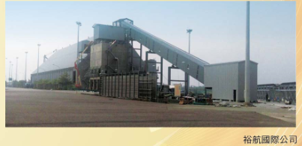
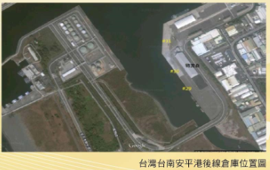
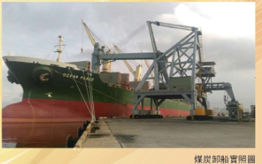
LEAD DATA INC.

Slide 6
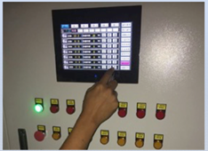

Agriculture Factory
The company has established an agriculture factory, equipped with advanced planting technologies. The factory has already produced over 40 kind of vegetables, and sale in several upscale supermarket chain.
Isolate outside pollution
Adjust temperature / humidity accordingly
All season production
Isolate pests, no need to use pesticides
Standardize production procedure
LEAD DATA INC.

Slide 7
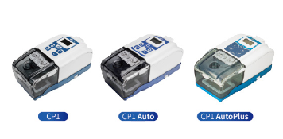
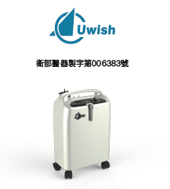

Medical Equipment
Our subsidiary Etop Union and ChungHong Electronics (Suzhou/Shenyang) entered medical equipment field since 2008. Dedicate to offer the market high quality medical aids.
Uwish CPAPs
Uwish Oxygen
Concentrator
Hearing Aid
LEAD DATA INC.

Slide 8
Finance and Operation Overview
LEAD DATA INC.

Slide 9
Income Statements Overview (Consolidated)
(NTＤ：Ｋ) |  | Q3 2019 |  |  |  | Q2 2019 |  |  |  | Q1 2019
 |  | Amount |  | ％ |  | Amount |  | ％ |  | Amount |  | ％
Sales |  | 137,908 |  | 100 |  | 206,737 |  | 100 |  | 151,983 |  | 100
Gross profit |  | (68,689) |  | (50) |  | (21,337) |  | (10) |  | (32,899) |  | (22)
Operating Income |  | (115,554) |  | (84) |  | (66,448) |  | (32) |  | (98,998) |  | (65)
Income before tax |  | (61,690) |  | (45) |  | (58,626) |  | (39) |  | (100,218) |  | (66)
Net income |  | (67,825) |  | (49) |  | (47,849) |  | (23) |  | (93,837) |  | (62)
EBITDA |  | (29,830) |  |  |  | (21,658) |  |  |  | (64,589)
EPS |  | (0.46) |  |  |  | (0.47) |  |  |  | (0.72)
LEAD DATA INC.

Slide 10
Sales Breakdown
(NTD：K) |  | Q3 2019 |  |  |  | Q2 2019 |  |  |  | Q1 2019
 |  | Amount |  | ％ |  | Amount |  | ％ |  | Amount |  | ％
Trading |  | 106,513 |  | 77 |  | 180,781 |  | 87 |  | 113,041 |  | 74
Machinery |  | 13,732 |  | 10 |  | 3,143 |  | 2 |  | 16,274 |  | 11
Transportation |  | 5,829 |  | 4 |  | 1,341 |  | 1 |  | 5,652 |  | 4
Medical equipment |  | 11,834 |  | 9 |  | 21,472 |  | 10 |  | 17,016 |  | 11
Total |  | 137,908 |  | 100 |  | 206,737 |  | 100 |  | 151,983 |  | 100
LEAD DATA INC.

Slide 11
Balance Sheet Overview (Consolidated)
(NTD：K) |  | 2019.9.30 |  |  |  | 2019.6.30 |  |  |  | 2019.3.31
 |  | Amount |  | ％ |  | Amount |  | ％ |  | Amount |  | ％
Cash |  | 176,011 |  | 9 |  | 219,294 |  | 11 |  | 118,802 |  | 7
CFAFV |  | - |  | - |  | - |  | - |  | 36,617 |  | 2
Account receivable |  | 69,061 |  | 3 |  | 49,428 |  | 2 |  | 55,878 |  | 3
Inventory |  | 293,393 |  | 15 |  | 312,335 |  | 16 |  | 302,852 |  | 16
Other current assets |  | 174,114 |  | 9 |  | 168,683 |  | 9 |  | 43,699 |  | 2
PPE & investment property |  | 516,473 |  | 26 |  | 526,670 |  | 27 |  | 545,925 |  | 29
Right-of-Use Asset |  | 138,185 |  | 7 |  | 134,692 |  | 7 |  | 136,127 |  | 7
Total Assets |  | 2,016,455 |  | 100 |  | 1,990,378 |  | 100 |  | 1,870,588 |  | 100
Short-term Loan |  | 225,616 |  | 11 |  | 146,587 |  | 7 |  | 108,755 |  | 6
Accounts Payable |  | 220,266 |  | 11 |  | 219,535 |  | 13 |  | 228,697 |  | 12
Lease Liabilities |  | 73,643 |  | 4 |  | 68,472 |  | 3 |  | 69,808 |  | 4
Other Current Liabilities |  | 171,377 |  | 8 |  | 178,881 |  | 9 |  | 107,644 |  | 6
Shareholder’s Equity |  | 783,449 |  | 39 |  | 862,212 |  | 43 |  | 905,982 |  | 48
LEAD DATA INC.

Slide 12
Cash Flow Overview(Consolidated)
(NTD：K) |  | Q1~Q3 2019 |  | Q1~Q3 2018
Income before Tax |  | (209,558) |  | (287,490)
Depreciation & amortization |  | 90,106 |  | 62,315
Others |  | 156,124 |  | 183,074
Net Cash Provided (Used) by Operating Activities |  | 36,672 |  | (42,101)
Acquisition of Fix Assets & Investment Property |  | (282,906) |  | (180,331)
Others |  | 41,212 |  | 35,435
Net Cash Provided (Used) by Investing Activities |  | (241,694) |  | (144,896)
Increase/Decrease in Loans |  | 99,228 |  | (5,709)
Others |  | 155,513 |  | 164,050
Net Cash Provided (Used) by Financing Activities |  | 254,741 |  | 158,341
Effect of Exchange Rates Changes |  | 16,176 |  | (16,626)
Increase/Decrease in Cash |  | 65,895 |  | (45,282)
Cash at End of Period |  | 176,011 |  | 208,739
LEAD DATA INC.

Slide 13
Our Visions
Coal Sales Plan:
  To expand our market on medium and large industrial users.
  Enlarge our market share along with the expanding of logistic facilities of Anping Harbor.
Medical Equipment Sales Plan：
  For our mainland China sales plan, apart from consolidating the existing channels, we also cooperate with international first tier companies to enlarge the distribution channels.
LEAD DATA INC.

Slide 14
謝謝您的聆聽
Thank you
LEAD DATA INC.

